Slide 1

Week 6- The Socıo-polıtıcal and Economıc Lıfe ın the Early Mıddle Ages

Slide 2
The beginnings of Parliament
Magna Carta (1215): Although not a parliament in the modern sense, Magna Carta laid the groundwork for limiting the power of the monarchy and establishing principles of governance that would later influence the development of Parliament.
De Monfort’s Parliament (1258):Heavy spendings and foreign advisors of John’s son, Henry III led to the creation of the first parliament, a french word meaning a «discussion meeting». It was a council of nobles. (House of Lords)
Model Parliament (1295): King Edward I called together what became known as the Model Parliament, which included not only nobles and clergy but also commoners (two representatives) from the shires and boroughs. This marked the beginning of representation of different estates in the governance of the realm. (House of Commons)
Development of the House of Commons and House of Lords: Over the centuries, the two houses of Parliament took shape. The House of Commons gradually evolved to represent the common people, while the House of Lords represented the nobility and clergy.

Slide 3
Edward’s First Parliement
Several kings had made arrangements for taxation before, but Edward I was the first to create a "representative institution" which could provide the money he needed. This institution became the House of Commons. Unlike the House of Lords it contained a mixture of "gentry" (knights and otherwealthy freemen from the shires) and merchants from the towns. These were the two broad classes of people who produced and controlled England’s wealth.

Slide 4
"no taxation with out representation".
In 1275 Edward I commanded each shire and each town (or borough) to send two representatives to his parliament . These "commoners" would have stayed away if they could, to avoid giving Edward money. But few dared risk Edward's anger. They became unwilling representatives of their local community. This, rather than Magna Carta, was the beginning of the idea that there should be "no taxation with out representation".
England was special because the House of Commons contained a mixture of gentry belonging to the feudal ruling class and merchants and freemen who did not.

Slide 5
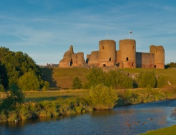
The union of England and Wales
(1284)
The Statute of Rhuddlan
Edward united West Wales with England.
The Statute of Rhuddlan: Edward was eager to invade Wales, but when the last king was defeated he easily took power in Wales. He used a variety of tactics to maintain English rule in Wales and incorporate it into his territory. He established the statute of Rhuddlan and made it a centre for the trial of local people and the administration of justice. The statute introduced English law and legal institutions into Wales, replacing traditional Welsh customs and legal practices. This further integrated Wales into the English legal system and strengthened English authority over the region.
The English considered that Wales had become part of England for all practical purposes.
Edward I made his own baby son Prince of Wales.
From that time the eldest son of the ruling king or queen has usually been made Prince of Wales.

Slide 6
Ireland and Scotland
Henry II made Dublin, the old Viking town, the capital of his colony (the Pale). However, much of western Ireland was ruled by Irish chiefs, while Norman lords governed the most of the east.
Edward I exploited the wealth of Ireland
The case in Scotland was totally different. Some English kings were accepted as «overlords». However, it was not easy for the English kings to conquer the Scots but Edward I was different and dedicated himself to invade and defeat them. https://www.youtube.com/watch?app=desktop&v=vuhLnq1FFZ8
He put John de Balliol on the Scottish throne but he was not welcomed by the Scottish nobles and encountered with Scottish resistance.
Resistance Movement
P. 33 William Wallace https://www.youtube.com/watch?v=6DQgXPHoMUw
Robert the Bruce
https://www.youtube.com/watch?v=lae33J7kkVY

Slide 7
The Growth of Government
Expansion of the Kingdom: As English kings expanded their territories, ruling not just England but also parts of France, the traditional model of direct royal governance became impractical. The sheer size of the kingdom made it impossible for the king to personally oversee every aspect of administration.
Delegation of Authority: To manage the increasing complexity of governance, English kings began delegating authority to nobles and knights from the royal household to act as sheriffs in different regions. These officials were responsible for enforcing the king's laws, collecting taxes, and administering justice locally.
Establishment of Administrative Centers: As the kingdom expanded and administrative needs grew, it became necessary to establish centralized administrative centers. Initially based in Winchester, the administrative hub shifted to Westminster during the reign of Edward I in 1290. Westminster became the focal point for governmental activities, housing key institutions such as the royal court and administrative offices.
Centralization of Power: Despite the establishment of administrative centers like Westminster, the real locus of power remained with the king. The phrase "the king's saddle" suggests that the ultimate authority and control resided with the monarch, regardless of the physical location of administrative offices.
Growth of Bureaucracy: The establishment of administrative centers and the delegation of authority led to the growth of bureaucracy. Officials appointed by the king carried out various administrative functions, including taxation, justice administration, and implementation of royal decrees. This bureaucratic structure facilitated the effective governance of the kingdom, allowing for more efficient management of resources and affairs.

Slide 8
Law and Justice
King was the law-maker and ultimate decision-maker.
Henry I introduced the idea that all crimes, even those inside the family, were no longer only a family matter but a breaking of the king’s peace.
«Circuit Judges» They dealt with crimes and disagreements over property.
«Common Law» The law administered by these travelling judges
Trial by Ordeal: Trial by ordeal was a legal practice where the accused person's guilt or innocence was determined by subjecting them to a physical test or trial, believed to be under divine intervention. The logic behind trial by ordeal was that if the accused were innocent, God would protect them from harm during the ordeal.
The accused person would be required to hold a hot iron on his tongue. After a certain period, typically three days, the wound would be examined. If the wound had healed cleanly, it was believed that God had intervened, indicating the person's innocence. However, if the wound festered or did not heal properly, it was interpreted as a sign of guilt.
https://www.youtube.com/watch?v=ve2tbdvCdmc

Slide 9
Trial by Jury
In England trial by ordeal was replaced with trial by jury. The jury idea dated back to the Danes of Danelaw, but had only been used in disputes over land. Henry II had already introduced the use of juries for some cases in the second half of the twelfth century. But it was not the kind of jury we know today. In 1179 he allowed an accused man in certain cases to claim "trial by jury" . Th e man could choose twelve neighbours, "twelve good men and true" . who would help him prove that he was not guilty. Slowly, during th e later Middle Ages, the work of these juries gradually changed from giving evidence to judging the evidence of others.
Juries had no training in the law. They were ordinary people using ordinary common sense . It was soon obvious that they needed guidance. As a result law schools grew up during th e thirteenth cent ury, producing lawyers who could advise juries about the points of law.

Slide 10
Religious Belief
Power conflict between the king and the Church
The struggle was mainly for the following reasons:
Church's Assertion of Authority: The Church, particularly the Catholic Church, sought to establish itself as the supreme authority not only in spiritual matters but also in secular or earthly affairs. It argued for the doctrine of "spiritual supremacy," asserting that all individuals, including kings, were ultimately answerable to God and therefore subject to the authority of the Church.
Desire for Control: The Church desired control over both spiritual and temporal realms to ensure its influence over all aspects of society. This included matters such as law, governance, and the appointment of bishops and other clergy.
Monarchs' Response: Kings and monarchs, however, often resisted the Church's attempts to exert control over secular matters. They saw themselves as rulers ordained by divine right and were reluctant to cede authority to the Church, particularly in matters concerning governance and the appointment of bishops.
Appointment of Bishops: One area of contention was the appointment of bishops. Kings sought to appoint bishops who would be loyal to them and support their political agenda. This allowed monarchs to influence the Church's hierarchy and ensure that bishops would prioritize the interests of the crown over those of the Church.
Conflict and Compromise: The struggle between the Church and monarchs often led to conflict and power struggles. However, there were also periods of compromise and cooperation, where both sides sought to balance their respective powers and interests
Brotherhoods of friers

Slide 11
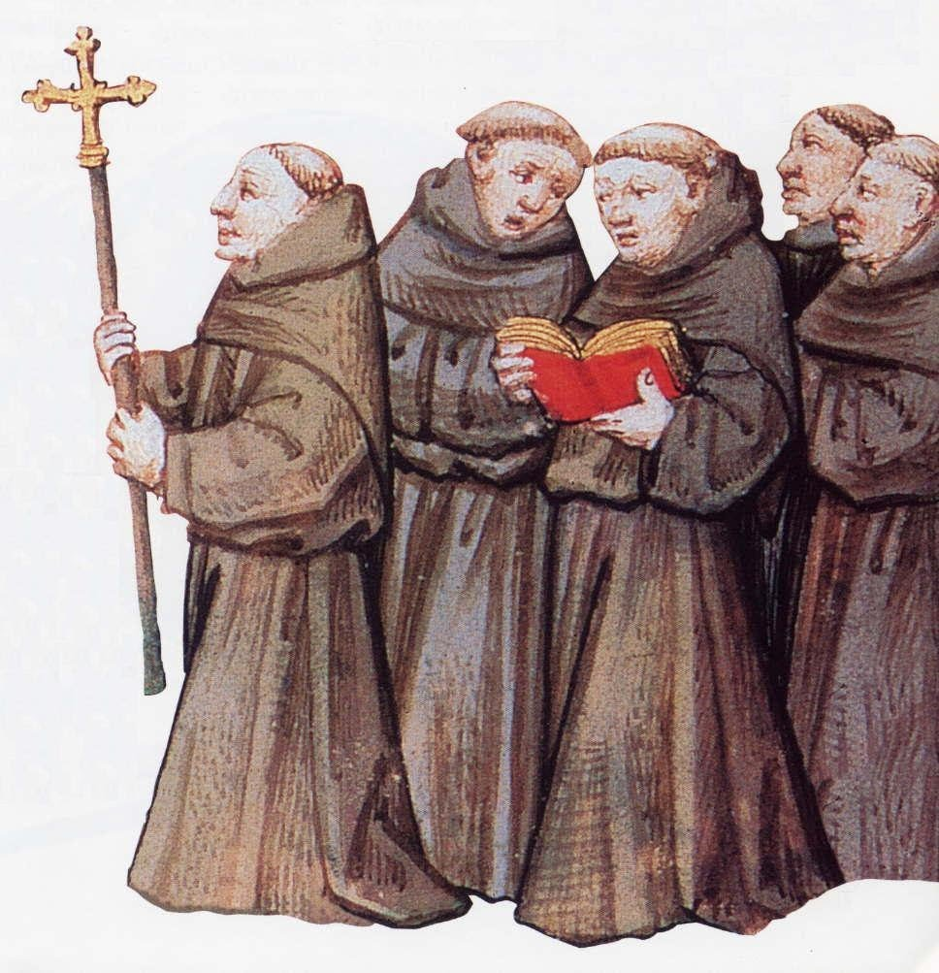
THE HOLY CATHOLIC CHURCH
The Friars: They were extra clergymen whose work was to look after the parishes (an ecclesiastical district,) who had no priest of their own.
The friars in the «brotherhood» were wandering preachers.
From the website COMUNITATS DE CONEIXEMENT

Slide 12
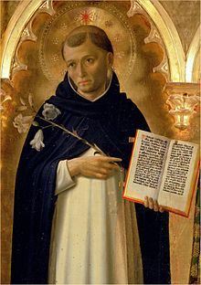
The two most important of all were the Franciscans (Grey Friars) and Dominicans (Black Friars)
These friars had their own “friaries” (branch offices)
Mendicant (begging) Friar: lives on what people gave them
From the website Wikipedia

Slide 13
The Cannons
helped to minister, to those who were without any other priest.
Those who lived strictly according to the rules of St. Augustine were called Augustinians.

Slide 14
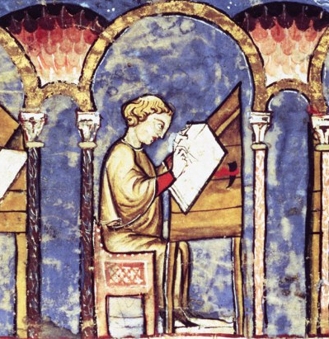
The Monks
From the website Dartmouth
were supposed to live strictly according to rule, and most of whom obeyed the rules of St. Benedict were known as Benedictines.
spent their time by copying books.
many wrote new chronicles – esp. chronicles

Slide 15
Ordinary people
Majority was serf and peasants.
Life in countryside was hard. Life was often harsh, with limited opportunities for social mobility and little protection from famine, disease, and conflict.
Shortage of food and price increases
Jewish Money lenders
Hatred for Norman rule (Robin Hood)

Slide 16
The Growth of towns as centres of wealth
Agricultural society, self-sufficient but needed things from abroad.
Trade/Import
Traveling traders, known as "chapmen" or "hucksters," played a crucial role in the wool trade. They would venture into rural areas and purchase wool directly from local producers at village markets. This direct exchange allowed rural communities to access markets beyond their immediate surroundings.
Transition from feudalism to town/city concept.
Charters of Freedom

Slide 17
Language Literature and Culture
Church Schools, Monasteries
Grammar Schools (Latin: language of education and church)
Oxford and Cambridge (first universities)
French (language of law and the Norman rulers)

